Slide 1

연구/개발팀 Android Studio 시작하기
정 승 훈 차장

Slide 2
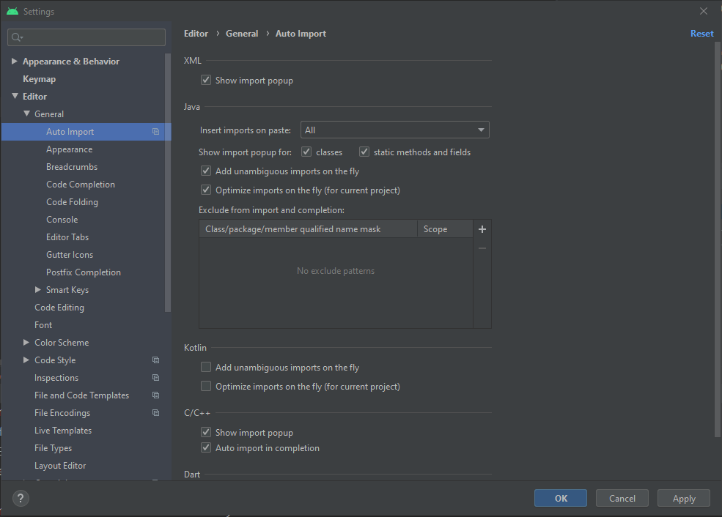
Android Studio 설정
Settings
Editor -> General -> Auto Import

Slide 3
Android Studio 단축키
Auto Alignment
Ctrl+Alt+L
Search Everywhere
Double Shift
Go to File
Ctrl+Shift+N
Recent Files
Ctrl+E
Navigation Bar
Alt+Home

Slide 4
Android Studio 단축키
Multi Select
Shift + Alt + Mouse Drag
Ctrl + Shift + Alt + j
Alt + j
Make Project
Ctrl+F9
Run
Shift+F10
Import Clear
Ctrl+Alt+O

